Slide 1


A predictive model for When in human memory
Paul Garrett¹
Hyungwook Yim²
Nathan Evans³
Vishnu Sreekumar⁴
Simon Dennis⁵
The University of Newcastle¹
The University of Tasmania²
Vanderbilt University³
NIH Research Laboratories⁴
University of Melbourne⁵

Slide 2

Beyond Model Selection
The goal of psychology is to explain and predict behaviour.
A Science becomes practically useful when it makes reliable predictions about the real world.
For the most part, psychology isn’t quite there yet.
The goal of the current study was to predict performance in a memory task using real-world data.
Notes:
The goal of psychology is to explain and predict human behaviour.
Other sciences, such as physics and chemistry, are practically useful because they make reliable real-world predictions.
Psychology, for the most part, is not quite there yet.
To date, psychology has faced two main obstacles to predictive models:
The means of collecting large quantities of real-world data
The tools to predict behaviour using this real-world data
Recent advancements in smart technologies such as phones and watches, allows us to create designer apps that can passively collect enormous amounts of real-world data on each and every subject.
Similar advancements in machine learning and predicative algorithms, allows us to use this real world data to make useful predictions about human behaviour.
Today, I will discuss my recent work using smart phone technology, to build a predictive model for When in human memory.

Slide 3
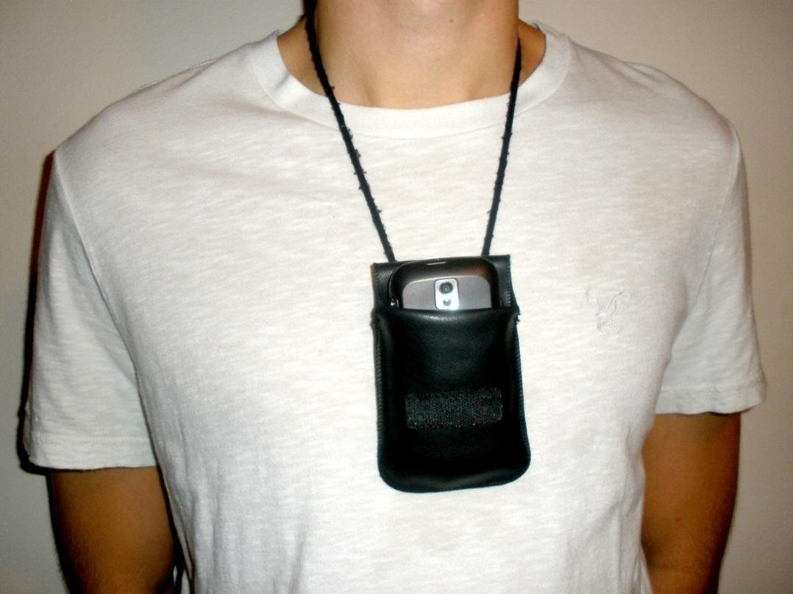
Life Logging In Style
Move away from laboratory based testing.
We collect dense data about an individuals life.
Then try to predict their memory for real life events!
Notes:
Typically, memory research is conducted in a lab setting. Participants are shown stimuli on a monitor, such as playing cards, and at a later stage of testing, are asked to recall or recognise whether the card had previously been presented.
These experiments occur under unnatural settings, with the goal of explain real-world behaviour. But a single hour session testing a very specific memory trace does not necessarily generalise to the memories we form in the real world over days, and even weeks.
My current study moves beyond the laboratory. Over a two week period, we use smartphones to collect dense data about an individual subject’s life-events and use this data to predict their memory for real world events.

Slide 4

Collection Phase
Raw Features
Images
GPS
Audio
Accelerometer
Notes:
During collection, participants were given a smartphone to wear Monday to Friday, for a period of two weeks. At regular time intervals, the Unforgettable Me app would trigger and capture information about the subject’s world, including images, GPS locations, 3 second audio segments and accelerometer data.

Slide 5
Collection Phase
Raw Features
Discretization
Representation
Images
Bag of Worlds
1, 10, 5, 20, 0, 5, 8, 30
Time(t)
GPS
Bag of Worlds
25, …, 5, …, 10, … 28
Time(t)
Audio
Bag of Worlds
13, …, 19, …, 10, … 7
Time(t)
Accelerometer
Bag of Worlds
3, …, 26, …, 12, … 18
Time(t)
Notes:
When the phone was charged and had access to a WiFi network, the Unforgettable App would upload this data to our servers where it would be discretised into a representation of the event, which we accessed later for analysis.

Slide 6
Collection Phase
Raw Features
Augmented Data
Representation
Weather
‘Clear’
GPS + Time
Temperature
19.9ºC
Audio Classifier
‘Street’
‘Voice’
Moon Phase
‘First Quarter’
Notes:
By using combining information from the Event’s GPS and Timestamp, events could be further augmented with additional data. This included the weather, Temperature and an audio classifier which operates through a machine learning algorithm. This classifier sorted audio data into categories such as home or work. Or if you were near a busy road, or in the presence of other voices.
Now as everyone knows, Simon, Hyungwook and I are all hard-core astrologers, and so we thought it was important to include moon phase for this analysis. In fact, this is our sanity check because moon-phase should not be predictive of human memory.
Alone, each piece of data is a novelty, an entirely forgettable instance of human memory. But taken together, create a faithful representation of a real-life event.

Slide 7
A Real World Representation
Keywords:
Clear Weather
Winter
Friday Morning
9am
audio_car
audio_voice
Kilometers 3.2
19°C
Moon Third Quarter
Notes:
For example, I did not recognise this coffee for what is was, until I viewed the additional data surrounding the image.
It was a clear Sunday morning, I walked 60m to the shops and caught up with a friend, and I asked them if they would be the last participant in this very life logging Study. And he said No.
Regardless of my failures as a recruiter, this example clearly demonstrates how collecting additional data leads to a more realistic representation of human memory.

Slide 8
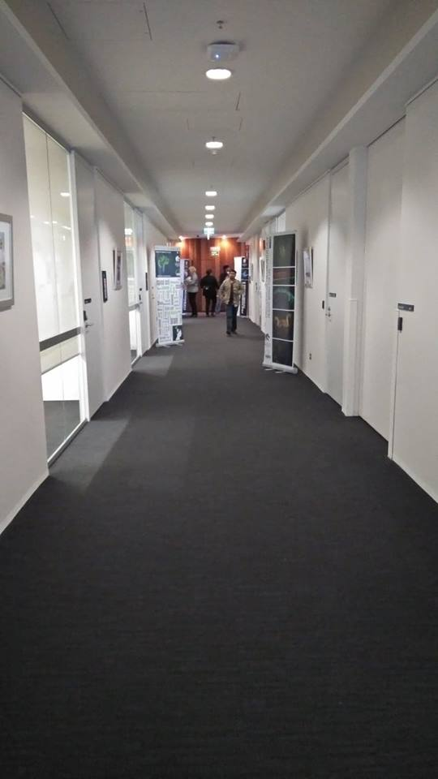


A Real World Representation
Keywords:
Clear Weather
Winter
Friday Morning
9am
audio_car
audio_voice
Kilometers 3.2
19°C
Moon Third Quarter
Notes:
For example, I did not recognise this coffee for what is was, until I viewed the additional data surrounding the image.
It was a clear Sunday morning, I walked 60m to the shops and caught up with a friend, and I asked them if they would be the last participant in this very life logging Study. And he said No.
Regardless of my failures as a recruiter, this example clearly demonstrates how collecting additional data leads to a more realistic representation of human memory.

Slide 9

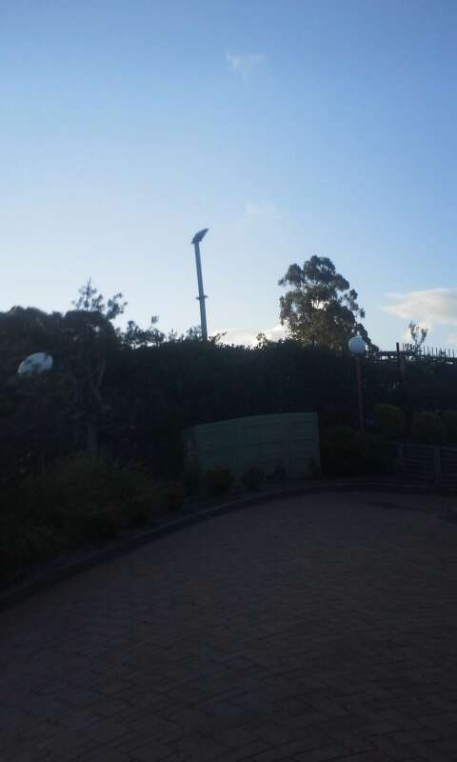

A Real World Representation
Keywords:
Clear Weather
Winter
Friday Morning
9am
audio_car
audio_voice
Kilometers 3.2
19°C
Moon Third Quarter
Notes:
For example, I did not recognise this coffee for what is was, until I viewed the additional data surrounding the image.
It was a clear Sunday morning, I walked 60m to the shops and caught up with a friend, and I asked them if they would be the last participant in this very life logging Study. And he said No.
Regardless of my failures as a recruiter, this example clearly demonstrates how collecting additional data leads to a more realistic representation of human memory.

Slide 10
Protocol
Collection Phase
Mon-Fri, 2 Weeks
Retention Phase
One Week
Test Phase
Online Experiment
Test Phase
Participants (N=15) viewed a series of images (M=71, SD=29) from their collection and reported:
Week of the Event (Week 1 or Week 2)
Day of the Event (Mon - Fri)
Hour of the Event (1 – 24)
Confidence in each timescale (5pt Likert Scale)
Emotional Valence of the event (5pt Likert Scale)
Notes:
After the two-week collection phase, participants underwent a one week retention interval, and completed the recognition memory test online on the third Friday.
During the test phase, participants were presented with an image from their collection phase and were asked to report from which Week, Day and Hour the image was selected.
Participants also reported their confidence in each of these time scales, and the emotional valence of the image. Both confidence and emotional valence were reported on a 5pt likert scale.
Collection rates differed across participants, but the average number of images tested was 71 with an SD of 29.
For simplicity, I’m going to focus the current analysis on the day decisions. If you are interested in results from these other response items, you should go and see Hyungwook’s talk later.

Slide 11
Focused Results
Results
Current results will focus upon recognition memory for the correct Day of the Week.
Mon-Fri, over 2 Weeks
10 Days to Recall
Caveat: Human memory is amazing…
Notes:
After the two-week collection phase, participants underwent a one week retention interval, and completed the recognition memory test online on the third Friday.
During the test phase, participants were presented with an image from their collection phase and were asked to report from which Week, Day and Hour the image was selected.
Participants also reported their confidence in each of these time scales, and the emotional valence of the image. Both confidence and emotional valence were reported on a 5pt likert scale.
Collection rates differed across participants, but the average number of images tested was 71 with an SD of 29.
For simplicity, I’m going to focus the current analysis on the day decisions. If you are interested in results from these other response items, you should go and see Hyungwook’s talk later.

Slide 12
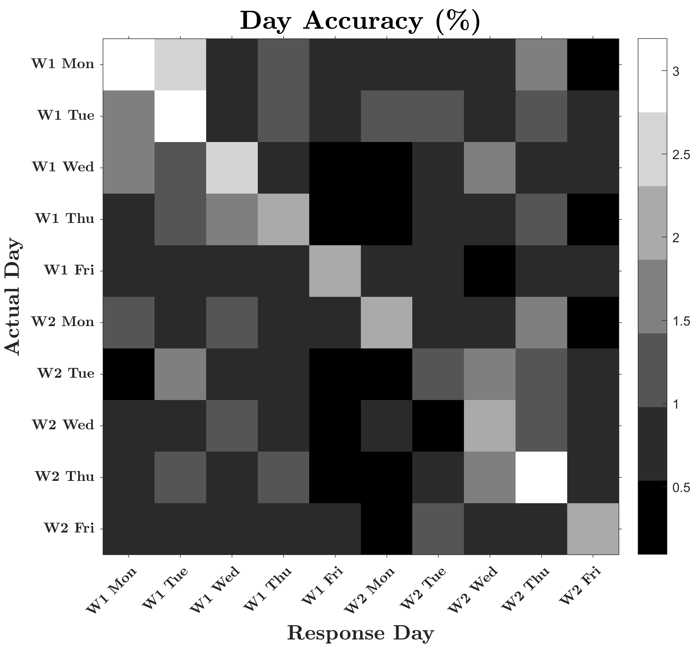
Day Discrimination Accuracy
Human Memory is Amazingly Inaccurate
10 Day Accuracy 23.83%
With so much variability, how can we predict memory performance?
By modelling Day to Day similarity
Notes:
Accuracy for day decisions, that is, the accuracy of reporting the correct day from the option of 10 days, was relatively low across subjects at 24%.
However, as you can see from this confusion matrix of accuracy for Reported Collection Days vs Actual Collection Days, there is a clear diagonal upon which participants respond. This indicates that participants are completing the task.
But with so much noise, it would be difficult to predict this behaviour with just accuracy alone. Here is where our real-world data can come into play.

Slide 13
Day Discrimination Analysis
Image Data
Days and Hours were broken into discrete events for each data stream.
Events were compared for similarity, between each hour of each alternate day.
E.g., Wednesday Week 1. 3pm
Tue
Wed
Thu
1pm
2pm
3pm
4pm
5pm
Notes:
To analyse the real-world data, we break each data stream, in this example it is the image data, into discrete hour blocks or events.
To compute a measure of similarity between days, we take the event hour in which an image occurred and compare this to each hour of each alternate day.

Slide 14
Day Discrimination Analysis
Image Data (JSD)
Similarity Scores were calculated independently for each modality
Image, Audio, GPS & Accel
Jenson Shannon Distances (JSD)
Weather, Audio Classifier & Moon
Hamming Distance (HD)
Temperature – Absolute Difference
Similarity
Of Each
Event
Between
Each
Days
Tue
Wed
Thu
Test Img 1
0.3
.8
1pm
0.1
0.05
0.9
0.5
2pm
0
Test Img 2
0.2
0
0
.2
Test Img 3
0.3
0.9
3pm
.1
0.2
4pm
0.6
0
.3
Test Img 4
0
0.8
.6
5pm
0.4
0.1
Test Img 5
Notes:
We then compute a measure of similarity between the test hour and each alternate hour. On each day, the hour which is most similar, that is which has the smallest distance score, is used to represent how similar that day is with reference to the test event.
In this way Days that have a similar event hour will be scored as being most similar, and days which have a dissimilar event hour will be scored as being most different.
This process is repeated for each test image independently for each data stream. We compute similarity scores of the phone data using Jenson Shannon Distances, for stings such as Weather using Hamming Distances, and for temperature using the absolute difference.

Slide 15
Day Discrimination Analysis
Conditional Logit Model
Four Primary Data Streams
Predicts Memory Better than Chance i.e., perplexity 10
Perplexity Guide
Uniform Random Perplexity = 10
Perfect Prediction Perplexity = 1
Perplexity = 8.589
Data | Params | p value
GPS | -1.131 | 0.001*
Audio | -1.109 | 0.001*
Accel | 0.933 | 0.002*
Image | -0.564 | 0.007*
Notes:
By computing the similarity for each day in this way, we can compare the impact of each real-world data stream on the ability for subjects to recall the correct day using a Conditional Logit Model. Here we have results from a conditional logit model for the four primary data streams, GPS, Audio, Accelerometery and Image. As you can see, each of the four data streams had a significant impact on the participants ability report the correct day.
Now this is really interesting, because we can rank these by order of importance. We show here that GPS and your background ambient sounds are most important. GPS makes sense, it is easy to imagine how distinguinshing between one location and another might contribute to memory. In some way, Audio functions in a similar way. Each location is hallmarked by its own unique ambient auditory signature. In this way, Audio might function as another proxy of location.
Next we have Accelerometry. It would make sense that both how you move and how often you move, both contribute to your memory. Jogging or running should produce quite unique memories as compared to sitting in your lab every day.
Finally, we have image. It is interesting that images are the least predictive since this is what we were testing participants on. This could be due to several reasons, but the simplest reason is our choice in image analysis tool, and this is something we will look further at in future.
Now that we have a model capturing how the real-data affects memory, we need to address our central question. How well does this model predict memory? To do this we borrow a measure from Machine Learning called perplexity. You can think of perplexity a measure of how well the model predicts memory, based upon how many alternate days are considered. For example, if the model were entirely predictive, it would only ever have to consider a single day, the correct day. In this case, perplexity would be equal to one. Now, if the model were non-predictive, then it would consider each day under a uniform random probability. In this case, the model would have a perplexity of 10. Our current model, using real world data, has a perplexity of 8.6 which means we are in fact predicting memory at better than chance levels using only four data streams. So, what happens when we do include the additional data streams?

Slide 16
Day Discrimination Analysis
Conditional Logit Model
Four Primary Data Streams
+ Augmenter Streams
Predication (Perplexity) Improves with Augmented Data
Perplexity Guide
Uniform Random, Perplexity = 10
Perfect Prediction, Perplexity = 1
Perplexity = 8.544
Data | Param | p value
GPS | -1.091 | 0.001*
Audio | -0.876 | 0.001*
Accel | 1.08 | 0.001*
Image | -0.449 | 0.038*
Moon Phase | -0.736 | 0.027*
Temperature | -0.033 | 0.106
Audio Classifier | -0.469 | 0.157
Weather | -0.019 | 0.964
Notes:
When we include the augmented data streams of Moon Phase, Temperature, the Audio Classifier and the Weather, we see that prediction improves. This means that we are better at predicting memory with the inclusion of more real-world data. What is also interesting, is that the only augmented stream that contributes significantly to the model, is our sanity check, moon phase. Now don’t get excited and start consulting your star charts, the moon didn’t make you forget your car keys or your sisters birthday. There is a rational explanation for why Moon Phase is significant in our model.

Slide 17
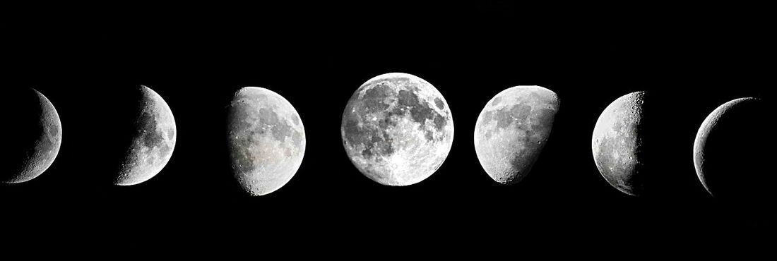
Day Discrimination Analysis
Moon Phase ( -0.736, p = 0.027*)
Primary (1 Night per Cycle)
New Moon, First Quarter, Full Moon, Last Quarter
Intermediary (5-7 Nights per Cycle)
Waxing Gibbous, Waning Gibbous, Waxing Crescent, Waning Crescent
Moon phase may be a proxy for time
Notes:
Each moon cycle can be broken into primary phases that last a single night, for example the Full Moon or New Moon; and intermediary phases that last between 5 and 7 nights. Because of these extended intermediary phases, the moon is probably acting as a proxy for the time of the week. So, if we can account for time in our logit model, moon phase should wash out.

Slide 18
Day Discrimination Analysis
Perplexity = 8.523
Conditional Logit Model
Four Primary Data Streams
+ Augmenter Streams + Time Scales
Predication Improves Again
Perplexity Guide
Uniform Random, Perplexity = 10
Perfect Prediction, Perplexity = 1
Data | Param | p values
GPS | -1.067 | 0.001*
Audio | -0.814 | 0.003*
Accel | 1.116 | 0.001*
Image | -0.399 | 0.07
Moon Phase | -0.662 | 0.072
Temperature | -0.028 | 0.172
Audio Classifier | -0.386 | 0.245
Weather | 0.042 | 0.922
Time of Day | -0.53 | 0.089
Day of week (Mon-Fri) | -0.052 | 0.146
Day (1 – 10) | 0.007 | 0.776
Notes:
And what do you know, when we account for the Time of Day, the Day of the Week (that is, was it a Monday or a Friday), and the actual Day (that is days 1 to 10), the effect of moon phase washes out. The addition of time data also has the effect of reducing perplexity and further improving prediction.

Slide 19
Conclusions
We have shown that life logging affords a real-world representation of human memory.
Our real-world data significantly contributed to participant’s memory for past events.
Using this data, we can predict memory performance better than chance. This prediction improved with additional data.
With further data, improved sampling methods and analysis tools, we aim to increase the predictive power of our model.
Notes:
We have shown that life logging affords a real-world representation of human memory.
Recorded real-world data significantly contributes to memory.
With real-world data, we can predict memory better than chance perplexity = 8.67 . Prediction improved with additional data.
Model predictions held at both the individual decision and individual subject level.

Slide 20
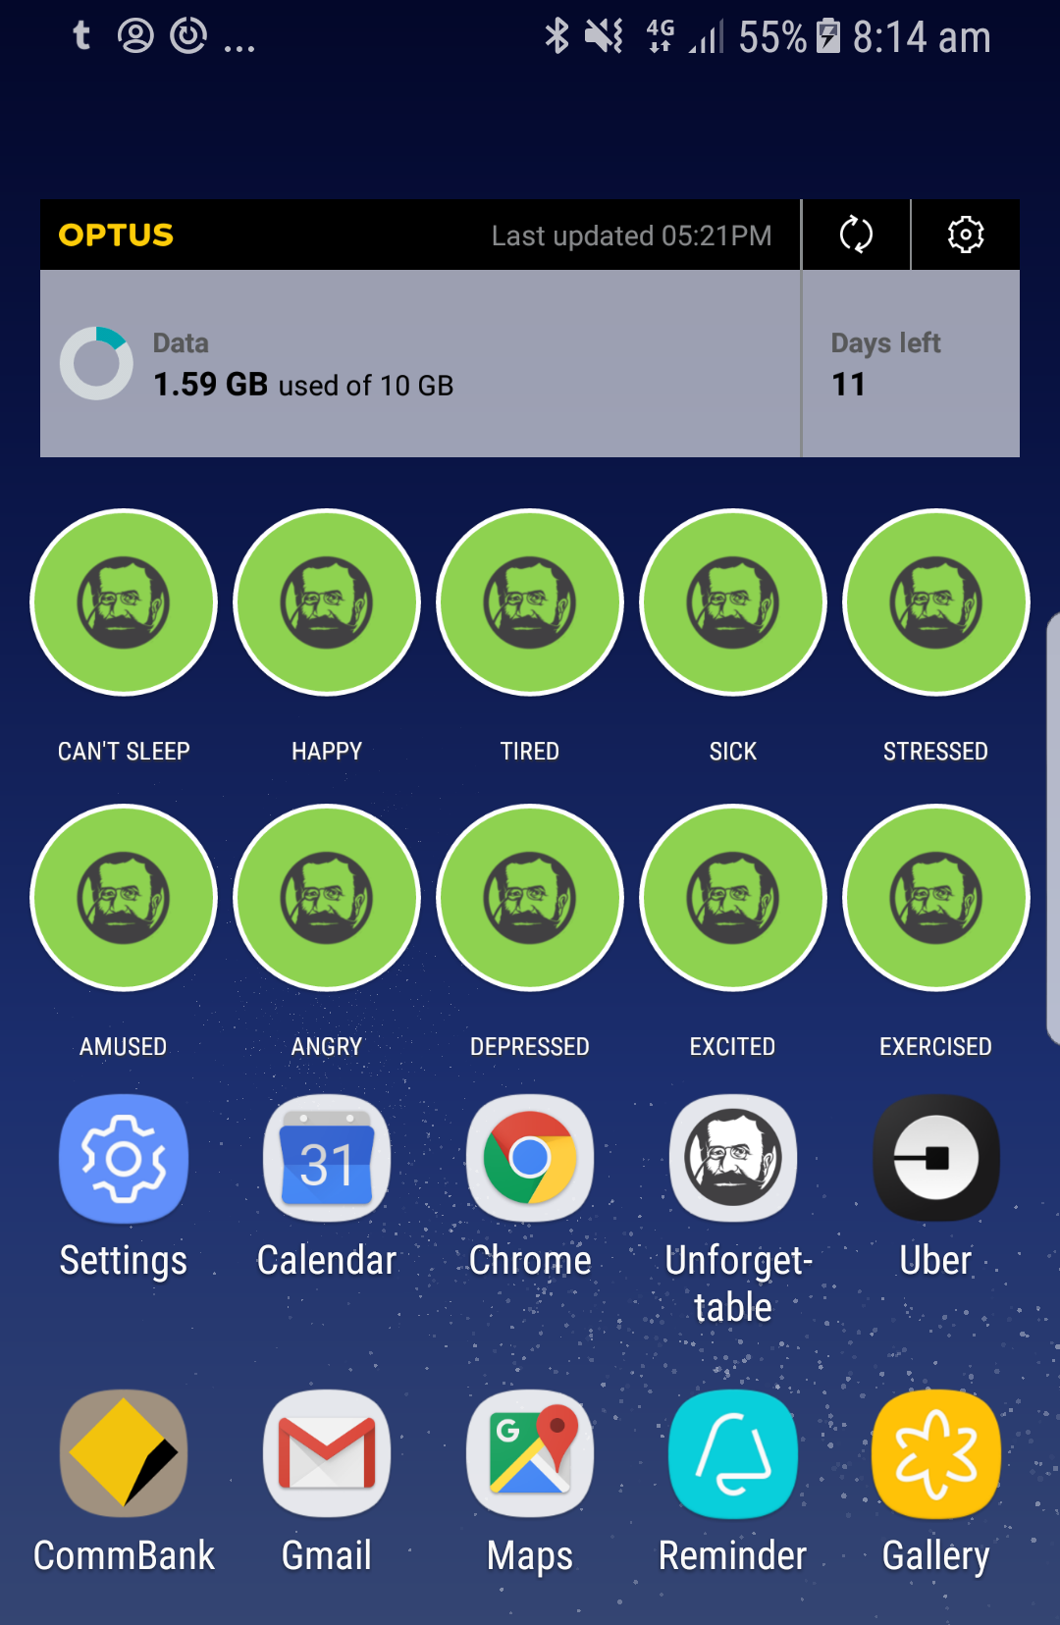
Future Directions
Predictions may be further improved with additional passive measures
SMS & Phone Calls
Emails and Diary Entries
Social Media Posts
Heart & Step Rate
And additional active measures
Emotional States
Meals & Weight
Personal and Social Activities
Notes:
Predictions may be further improved with additional passive measures
SMS & Phone Calls
Emails and Diary Entries
Social Media Posts
Heart & Step Rate
And additional active measures
Emotional States, Meals & Weight, Activities

Slide 21
Final Word
Explanatory models of behaviour are necessary for understanding the human brain.
But an explanation is not a prediction.
Psychology can and should be working to make informative and reliable predictions about the real world using real world data.
After all…
Notes:
Explanatory models are necessary for understanding the human brain.
But an explanation is not a prediction.
Psychology can and should be working to make informative and reliable predictions about the world.
After all…
We have the technology

Slide 22

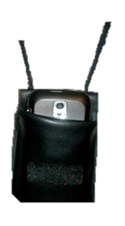
Final Word

Slide 23









Thank You
Simon Dennis Ben Stone Jihun Hamm Mikhail Belkin Vishnu Sreekumar Per Sederberg Troy Smith Dylan Neilson Hyungwook Yim
Nathan Evans
Students & Volunteers
Corrine McGann Gabrielle Matthews Kay Chan Samuel Collison Mhairi Gray Anita Gray Megan Baker Viviana Pinzon Morales Rachael Vince Alison Rasmussen Ruby Walker
Nicholas Bignall

Slide 24
Model Evaluation
Cross Validation
Assess how well the model predicts memory when given new data.
Leave-One-Decision-Out
Cross Validation
Perplexity = 8.716
All Data Perplexity = 8.523
N Decisions = 10660
Mon
Tue
…
8am
9am
10am
11am
…
Notes:
To assess how well the conditional logit model predicts memory, we applied cross validation. Now, cross validation is a model evaluation tool that assesses how well the model can predict the outcome of new data, based upon previous data sets. An extreme version of this is leave-one-decision-out Cross Validation.
Here, a single holdout event is removed from the total data set. The remaining data set is then used to predict the outcome of the held out event, with error calculated in terms of perplexity. This procedure is repeated for each event (N=10660), giving us a measure of perplexity at the level of a single decision. If the model is over fitting or under fitting on the training data sets, perplexity will increase and reflect this noisy estimation.
Now what was surprising, and really quite excellent about this model, is that perplexity increased as it should since you are removing data when performing cross validation, but only by a very small amount. This means that the predictions from this real-world data is very stable, and remains predictive at the individual decision level.

Slide 25
Model Evaluation
Cross Validation
Assess how well the model predicts memory when given new data.
Leave-One-Subject-Out
Cross Validation
Perplexity = 8.666
All Data Perplexity = 8.523
N Subjects = 15
Subject Events
Sub 1
Sub 2
…
…
Sub 15
Notes:
We also performed the same cross-validation method to assess the model at the level of the participant. Here we removed the data of an entire individual, and predicted their events using the data from the other 14 subjects. Again, we see that our measure of perplexity remains stable at around 8.6 and is indeed predictive at the participant leve
Model predictions held at both the individual decision and individual subject level.

Slide 26
Day Discrimination Analysis
Conditional Logit Model
Four Primary Data Streams
Predicts Memory Better than Chance
Perplexity Guide
Uniform Random Perplexity = 10
Perfect Prediction Perplexity = 1
Perplexity = 8.589
Data | Params | p value
GPS | -1.131 | 0.001*
Audio | -1.109 | 0.001*
Accel | 0.933 | 0.002*
Image | -0.564 | 0.007*
Accel Alone | -1.750 | 0.001*

Slide 27
Day Discrimination Analysis
Correlation Matrix
 | Accel | Audio | Image | Gps | Weather | Audio Class | Time | Moon | Temp | Day of Week | Day
Accel | 1 | 0.42 | 0.39 | 0.28 | 0.15 | 0.16 | 0.18 | 0.23 | 0.23 | 0.2 | 0.13
Mfcc | 0.42 | 1 | 0.67 | 0.34 | 0.26 | 0.27 | 0.25 | 0.43 | 0.25 | 0.36 | 0.21
Image | 0.39 | 0.67 | 1 | 0.27 | 0.25 | 0.2 | 0.22 | 0.42 | 0.24 | 0.34 | 0.23
Gps | 0.28 | 0.34 | 0.27 | 1 | 0.08 | 0.16 | 0.21 | 0.17 | 0.21 | 0.15 | 0.08
Weather | 0.15 | 0.26 | 0.25 | 0.08 | 1 | 0.06 | 0.09 | 0.18 | 0.14 | 0.15 | 0.12
Audio Class | 0.16 | 0.27 | 0.2 | 0.16 | 0.06 | 1 | 0.21 | 0.11 | 0.05 | 0.13 | 0.07
Time | 0.18 | 0.25 | 0.22 | 0.21 | 0.09 | 0.21 | 1 | 0.1 | 0.31 | 0.13 | 0.06
Moon | 0.23 | 0.43 | 0.42 | 0.17 | 0.18 | 0.11 | 0.1 | 1 | 0.21 | 0.34 | 0.35
Temp | 0.23 | 0.25 | 0.24 | 0.21 | 0.14 | 0.05 | 0.31 | 0.21 | 1 | 0.08 | 0.11
Day of week | 0.2 | 0.36 | 0.34 | 0.15 | 0.15 | 0.13 | 0.13 | 0.34 | 0.08 | 1 | 0.24
Day | 0.13 | 0.21 | 0.23 | 0.08 | 0.12 | 0.07 | 0.06 | 0.35 | 0.11 | 0.24 | 1

Slide 28

Experimental Procedure
Experimental Procedure
Two Weeks
Collection
Avg 71 Test Images
Experiment
3 Questions
Response
Hour (1-24)?
Day (Mon-Fri)?
Week (W1, W2)?
Prediction
Avg Test Images 71 (SD = 29), range 22-122
Notes:
Typically, memory research is conducted in a lab setting. Participants are shown stimuli on a monitor, such as playing cards, and at a later stage of testing, are asked to recall or recognise whether the card had previously been presented.
These experiments occur under unnatural settings, with the goal of explain real-world behaviour. But a single hour session testing a very specific memory trace does not necessarily generalise to the memories we form in the real world over days, and even weeks.
My current study moves beyond the laboratory. Over a two week period, we use smartphones to collect dense data about an individual subject’s life-events. We then use this data to generate a recognition memory study, where subjects are shown an image and are asked
the answers to which we apply and build a model to predict when subjects
We then use this data to generate a recognition memory study, where participants are shown an image from their collection phase and are asked to recall the hour, the day, and the week on which it occurred. These responses are then fed

Slide 29

Experimental Procedure
Test Image
Response
Predictive
Model
Hour (1-24)
Day (Mon-Fri)
Week (W1, W2)
Notes:
Typically, memory research is conducted in a lab setting. Participants are shown stimuli on a monitor, such as playing cards, and at a later stage of testing, are asked to recall or recognise whether the card had previously been presented.
These experiments occur under unnatural settings, with the goal of explain real-world behaviour. But a single hour session testing a very specific memory trace does not necessarily generalise to the memories we form in the real world over days, and even weeks.
My current study moves beyond the laboratory. Over a two week period, we use smartphones to collect dense data about an individual subject’s life-events. We then use this data to generate a recognition memory study, where subjects are shown an image and are asked
the answers to which we apply and build a model to predict when subjects
We then use this data to generate a recognition memory study, where participants are shown an image from their collection phase and are asked to recall the hour, the day, and the week on which it occurred. These responses are then fed

